Slide 1
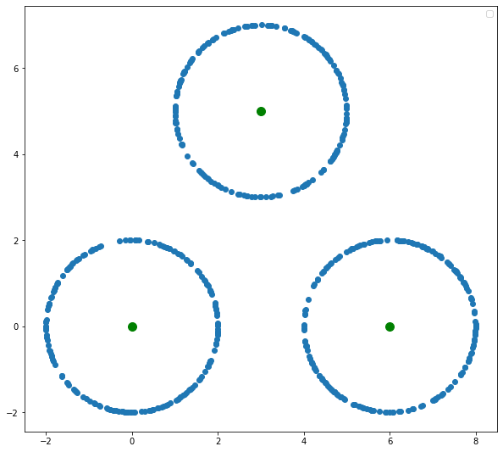

Slide 2
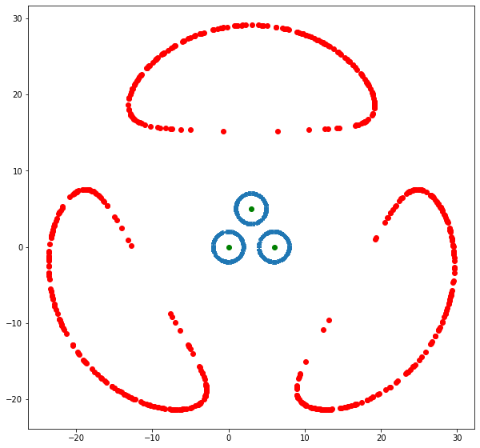
loss+= -1*((pdist(point, c1)) + (pdist(point, c2)) + (pdist(point, c3)))

Slide 3
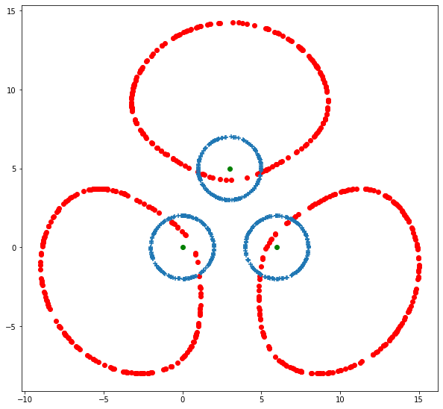
BUT…

Slide 4
Idea
Strongly penalize if a point is near the centroid

Slide 5
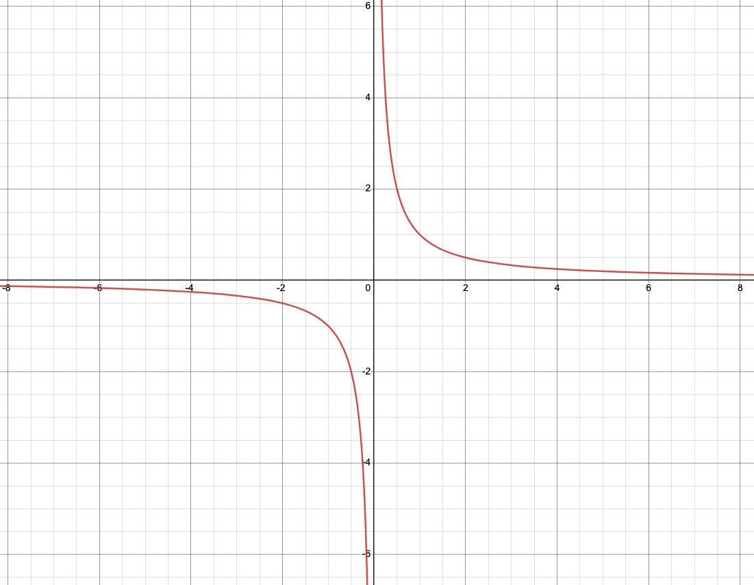
y = 1/x

Slide 6
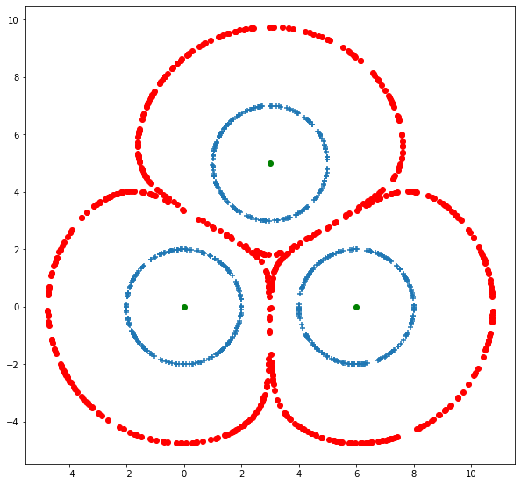
z += ((1/pdist(point, c1)) + (1/pdist(point, c2)) + (1/pdist(point, c3)))

Slide 7
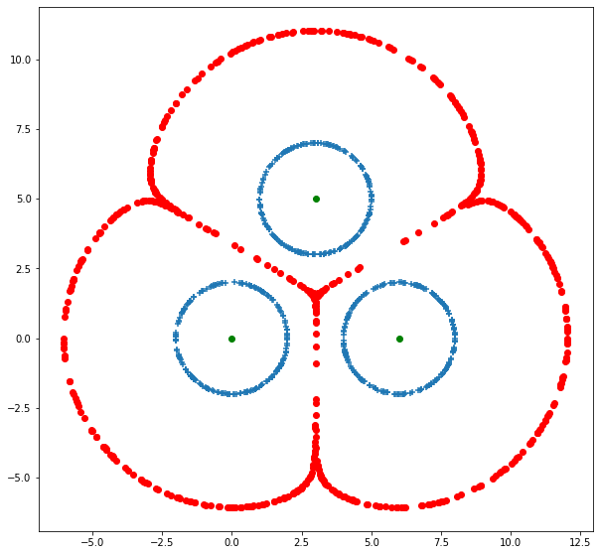

Slide 8
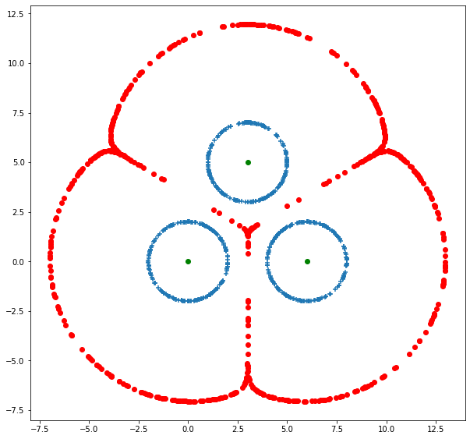

Slide 9
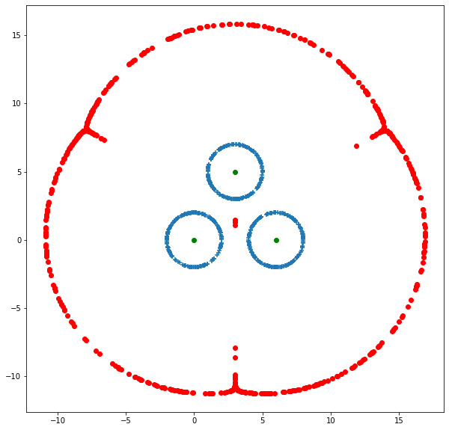

Slide 10
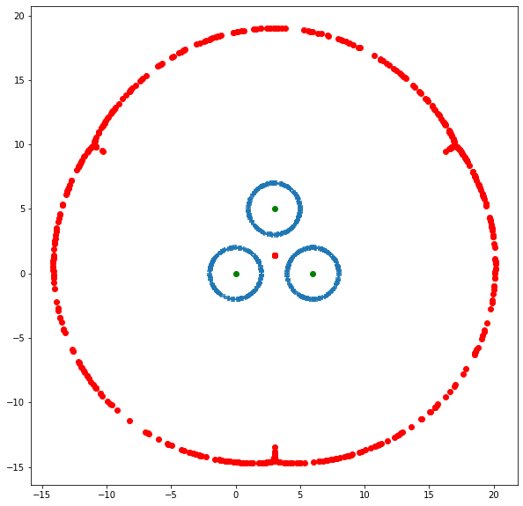

Slide 11
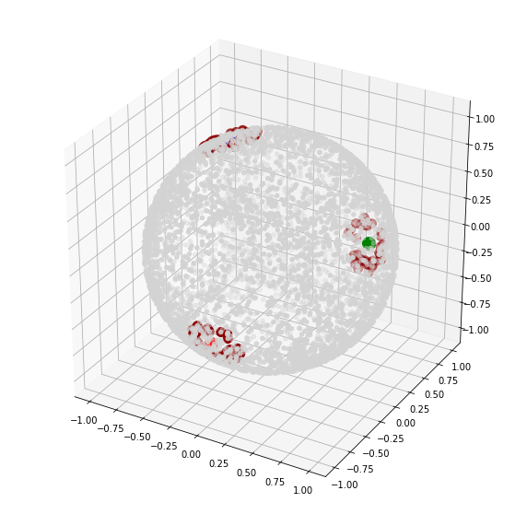
Hypersphere

Slide 12
Distance ~ (-cos theta)

Slide 13
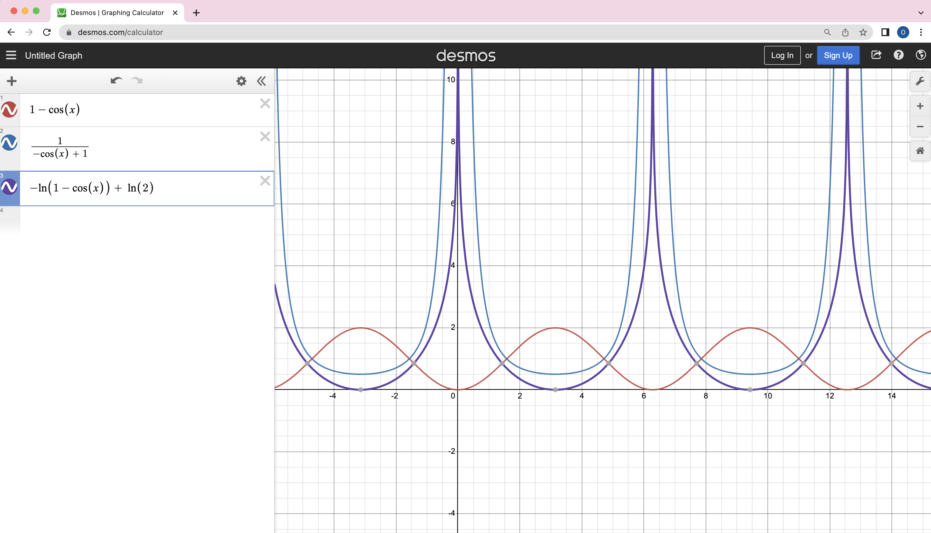

Slide 14
loss +=
-1*(torch.log(1 - cos_1)) + torch.log(torch.tensor(2)) +
-1*(torch.log(1 - cos_2)) + torch.log(torch.tensor(2)) +
-1*(torch.log(1 - cos_3)) + torch.log(torch.tensor(2))

Slide 15
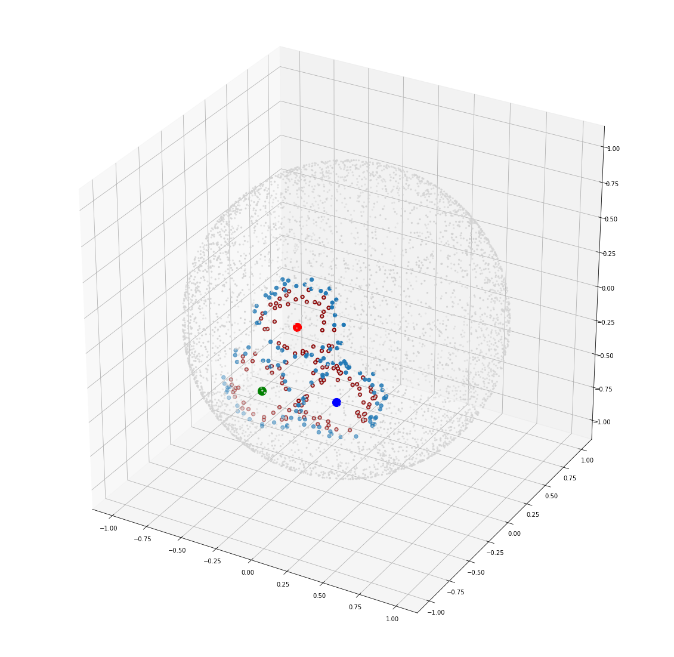

Slide 16
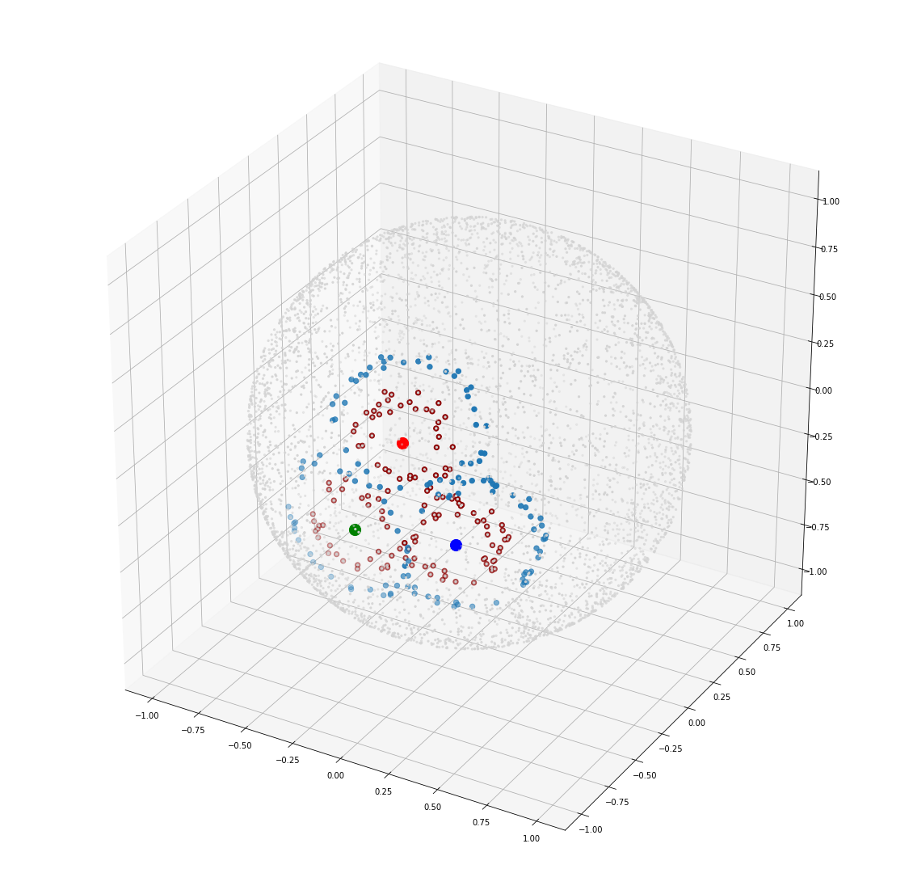

Slide 17
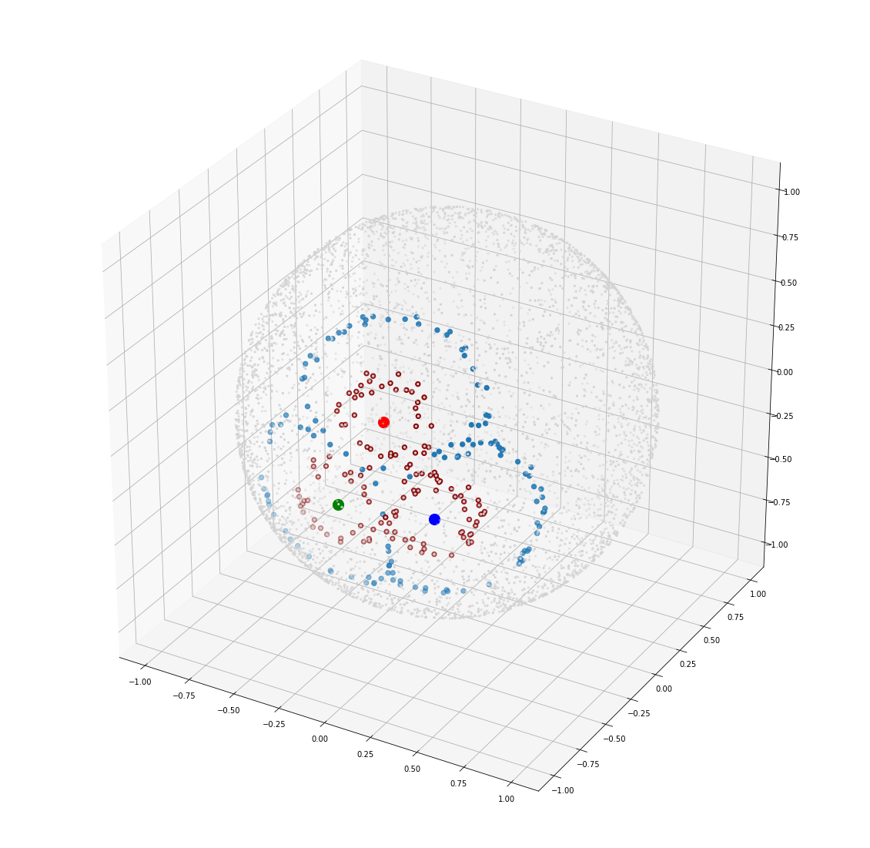

Slide 18
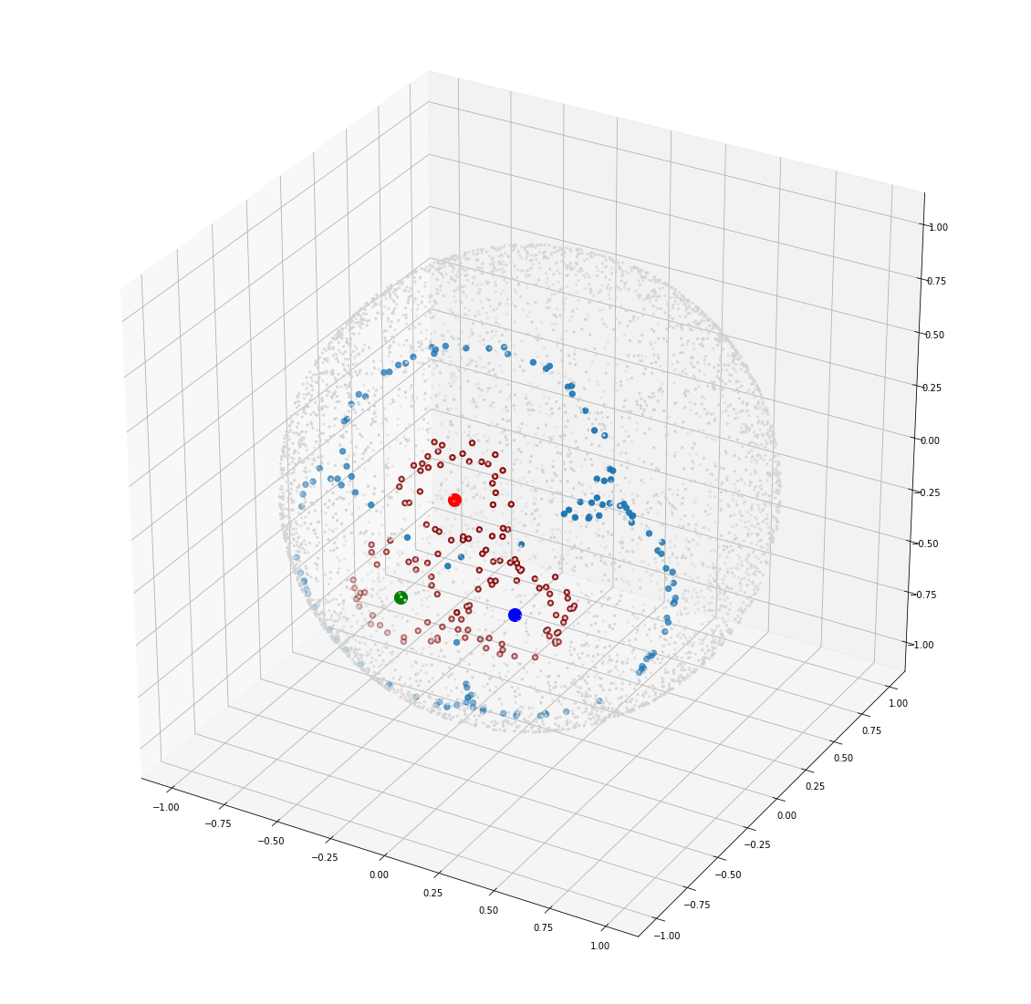

Slide 19
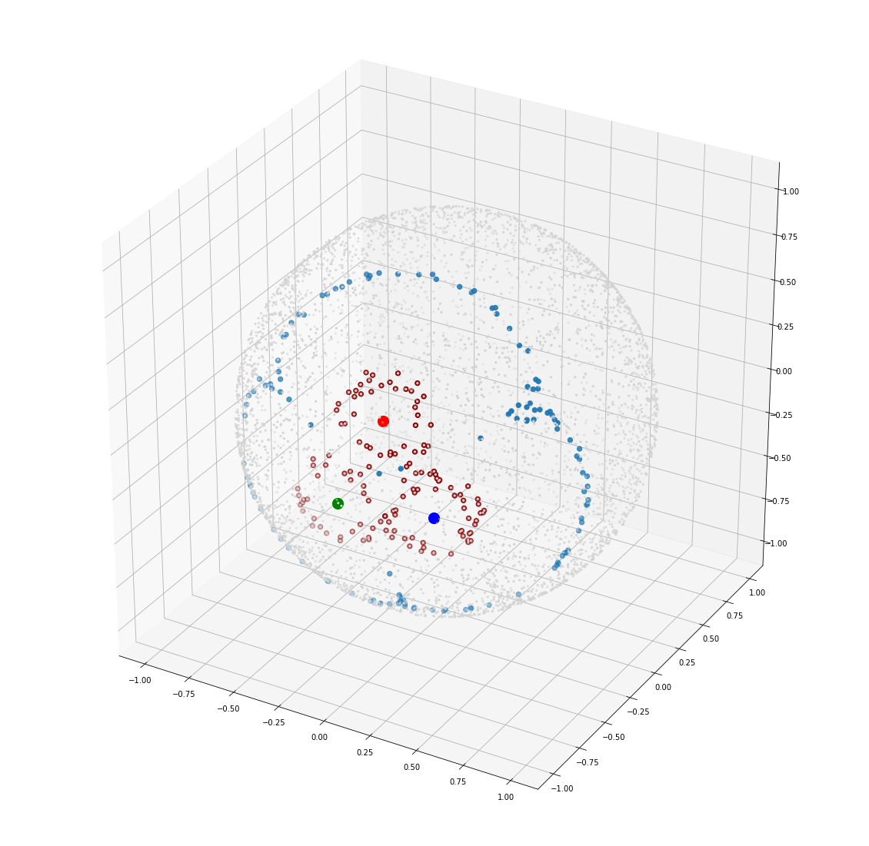

Slide 20
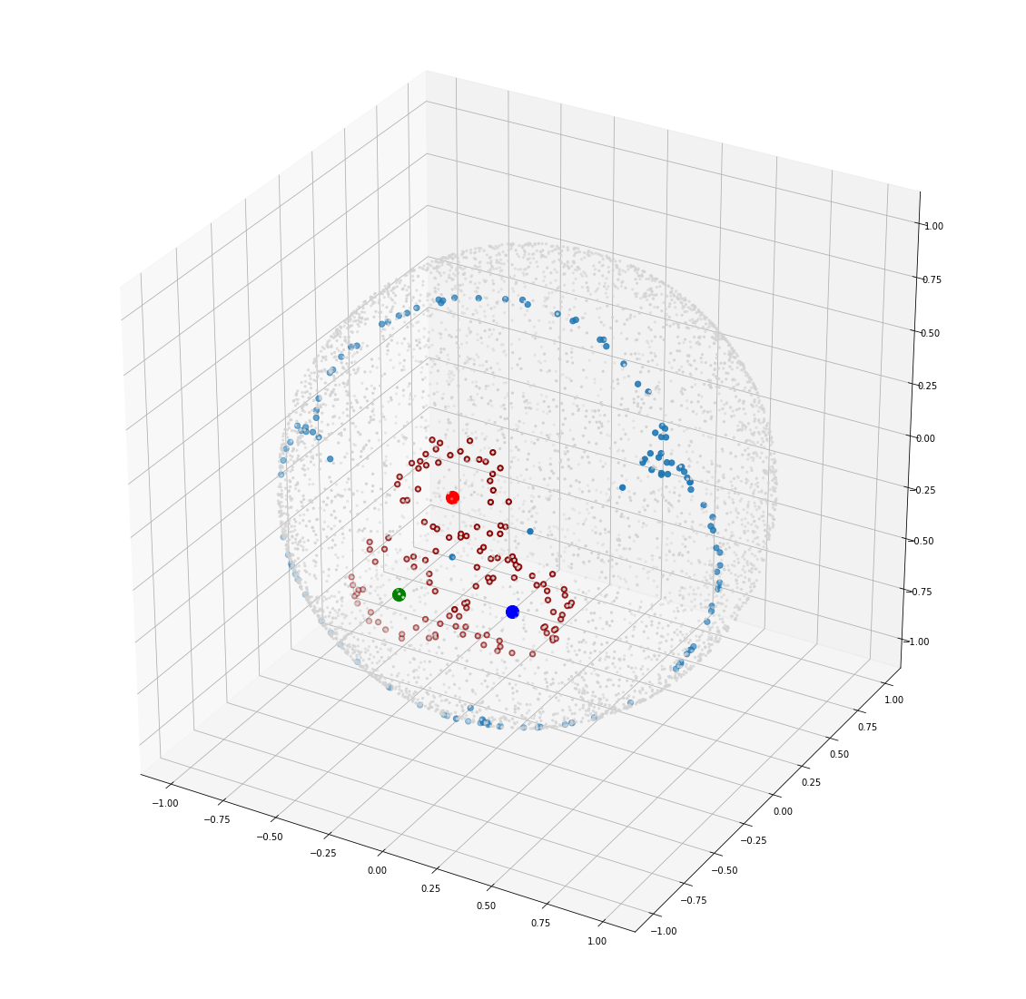

Slide 21
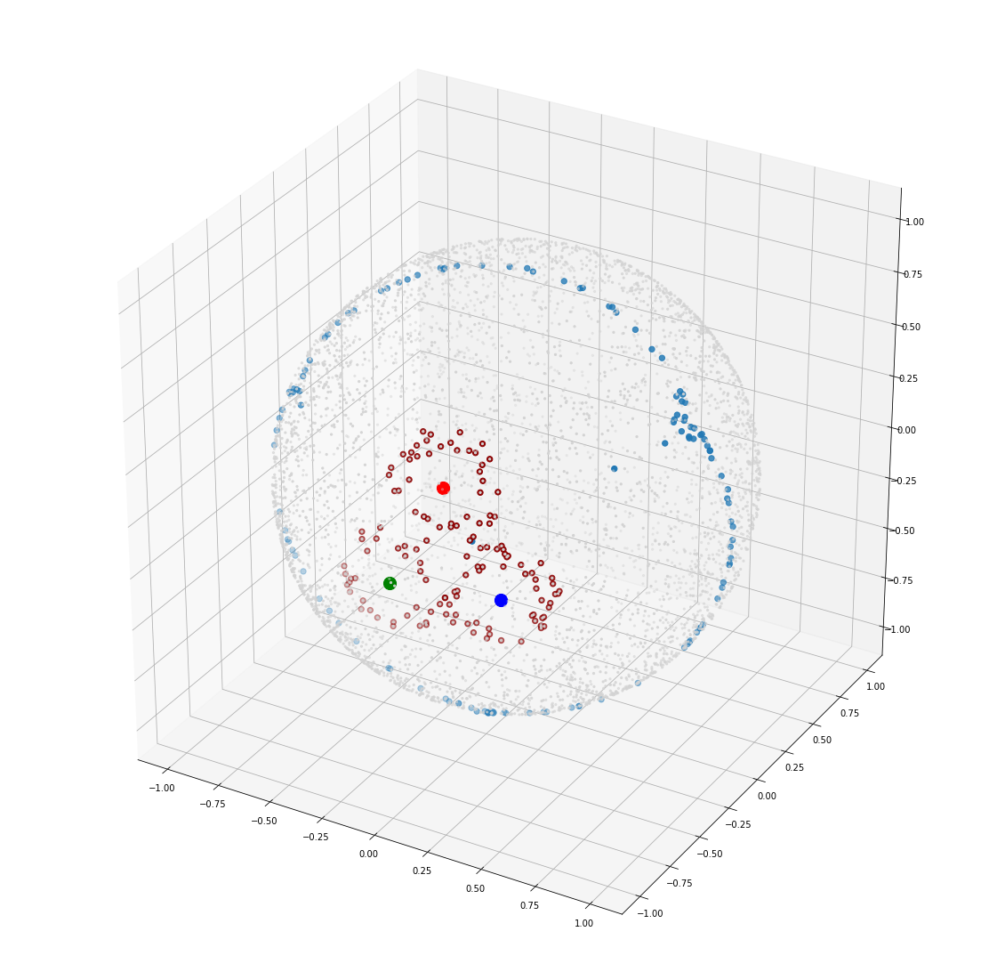

Slide 22
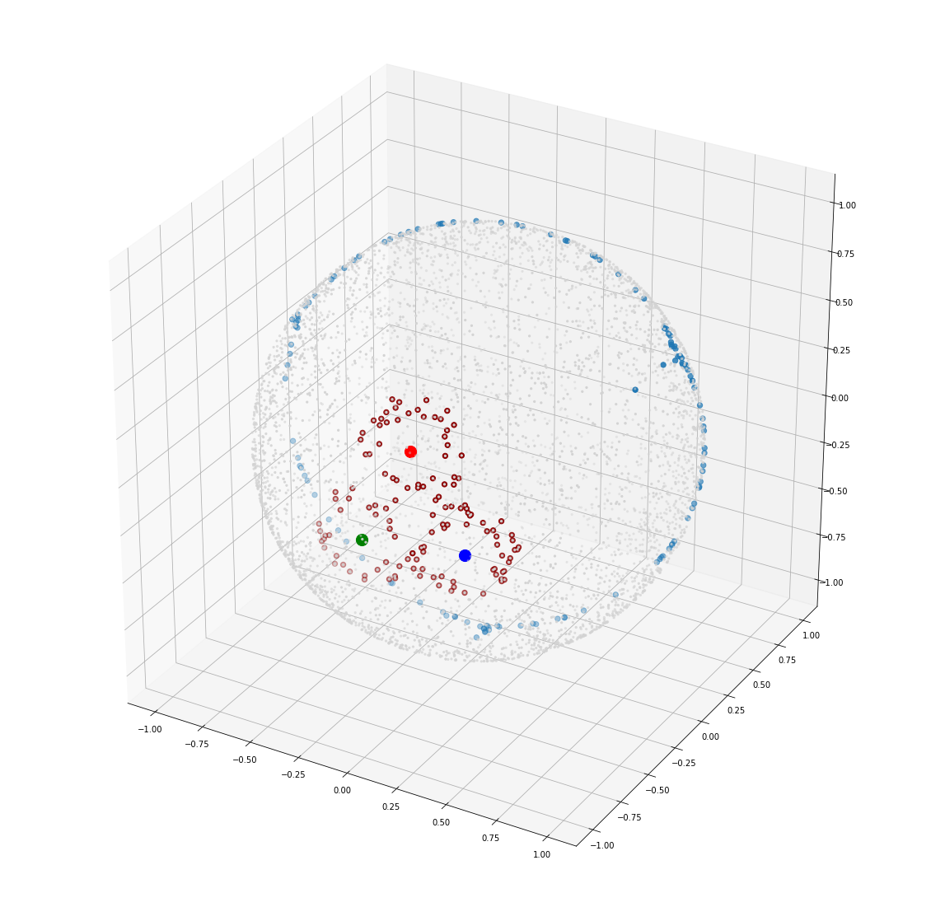

Slide 23
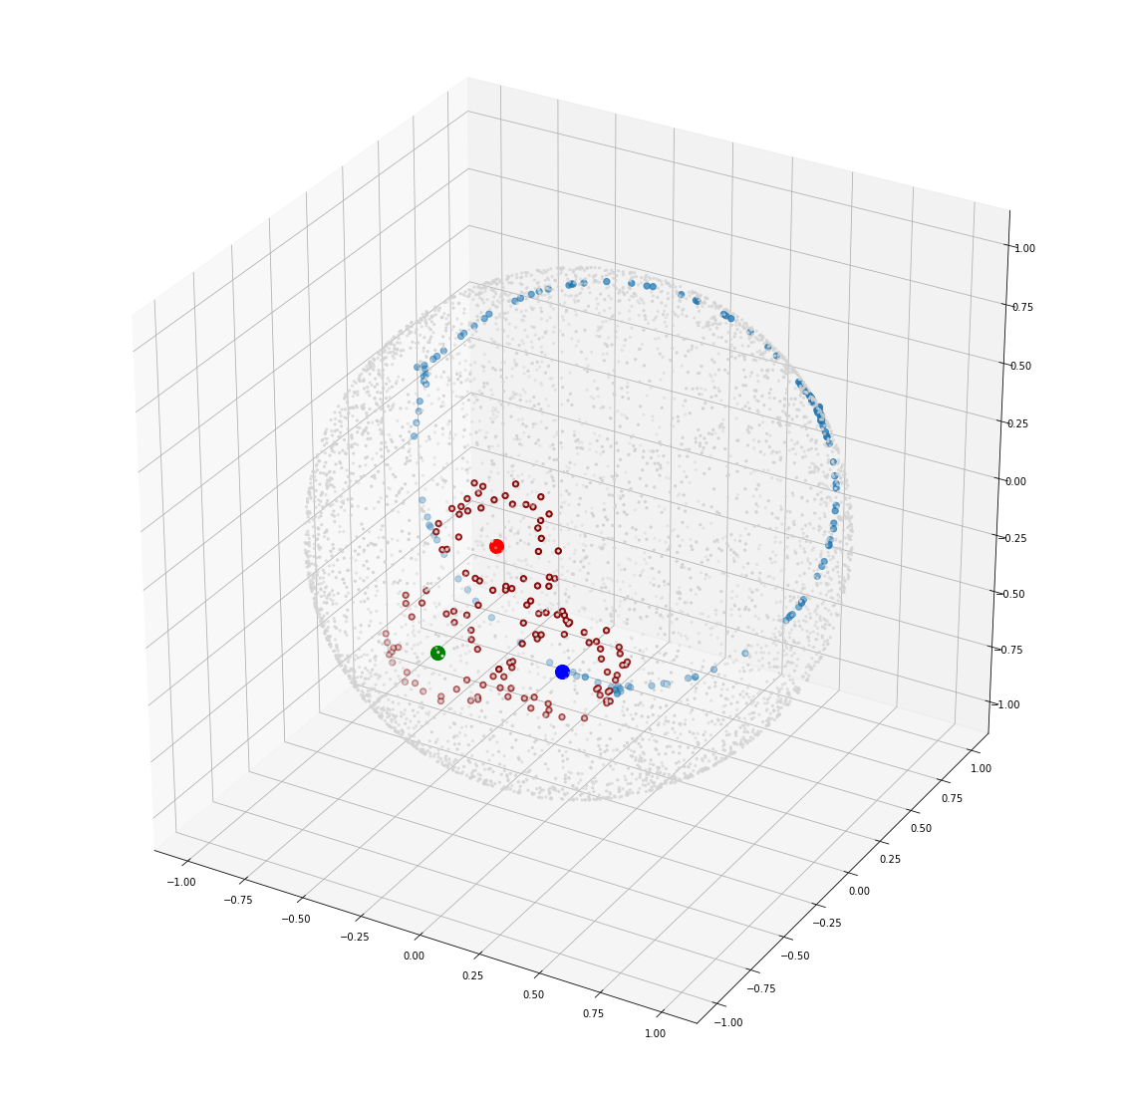

Slide 24
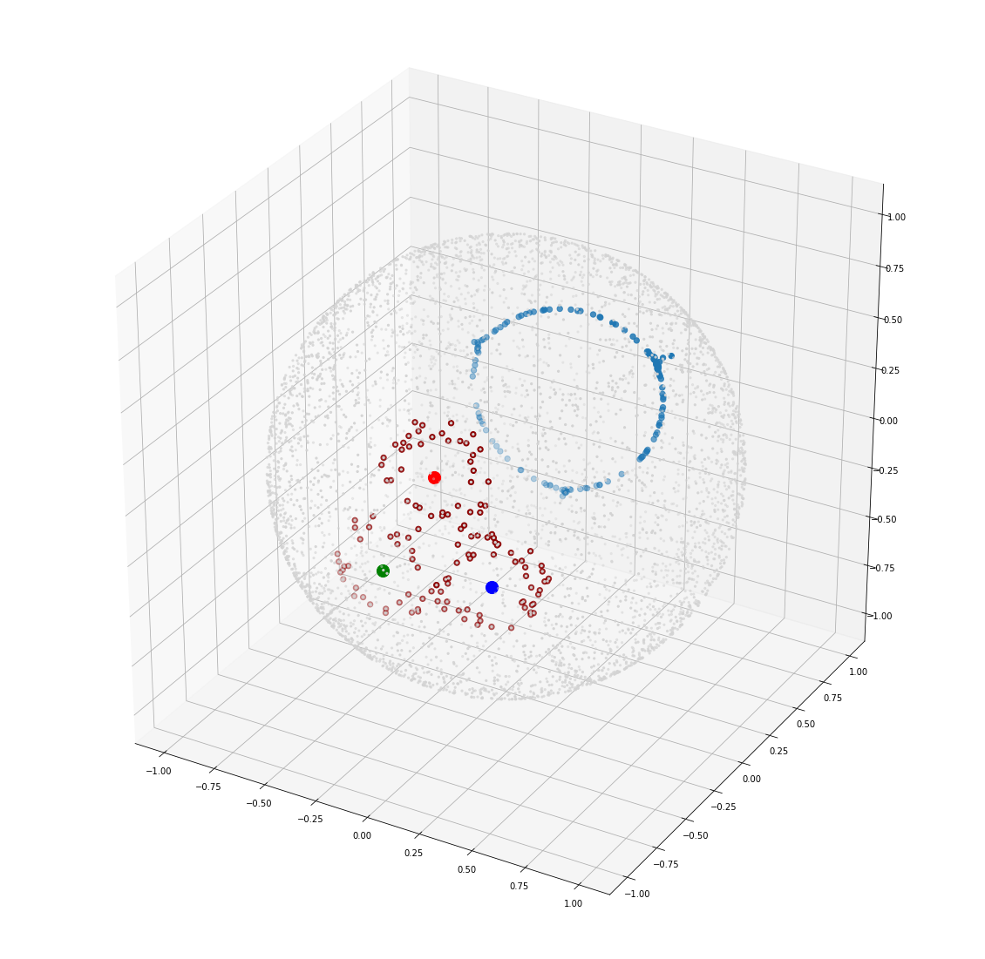

Slide 25
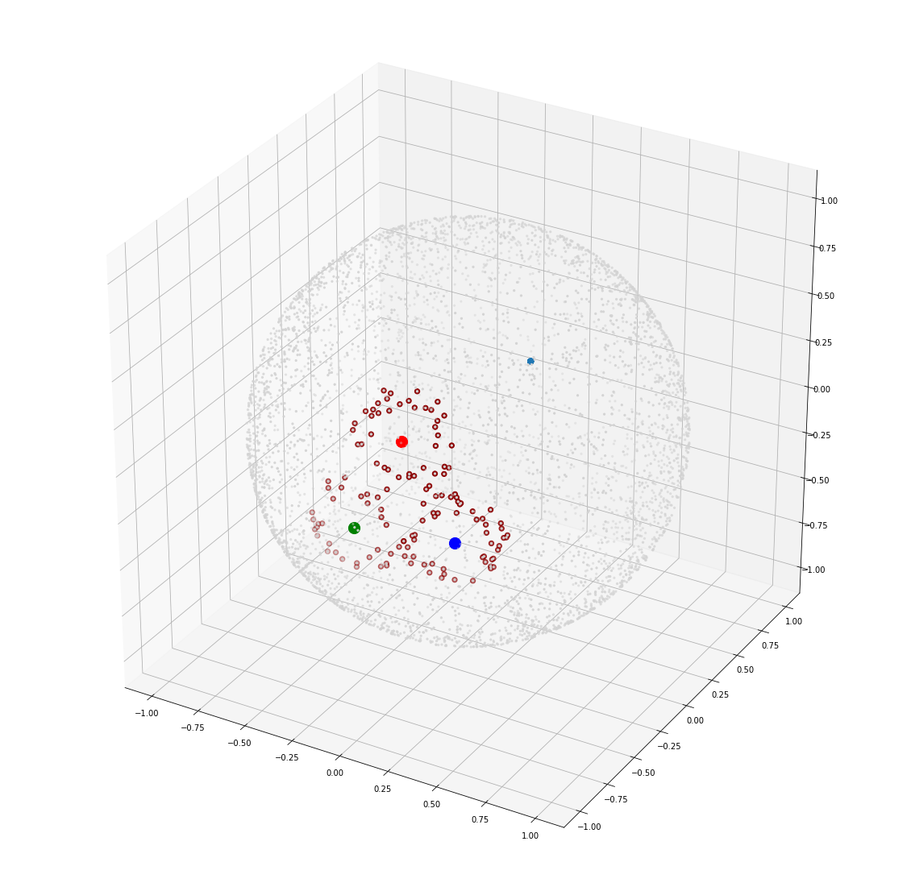

Slide 26
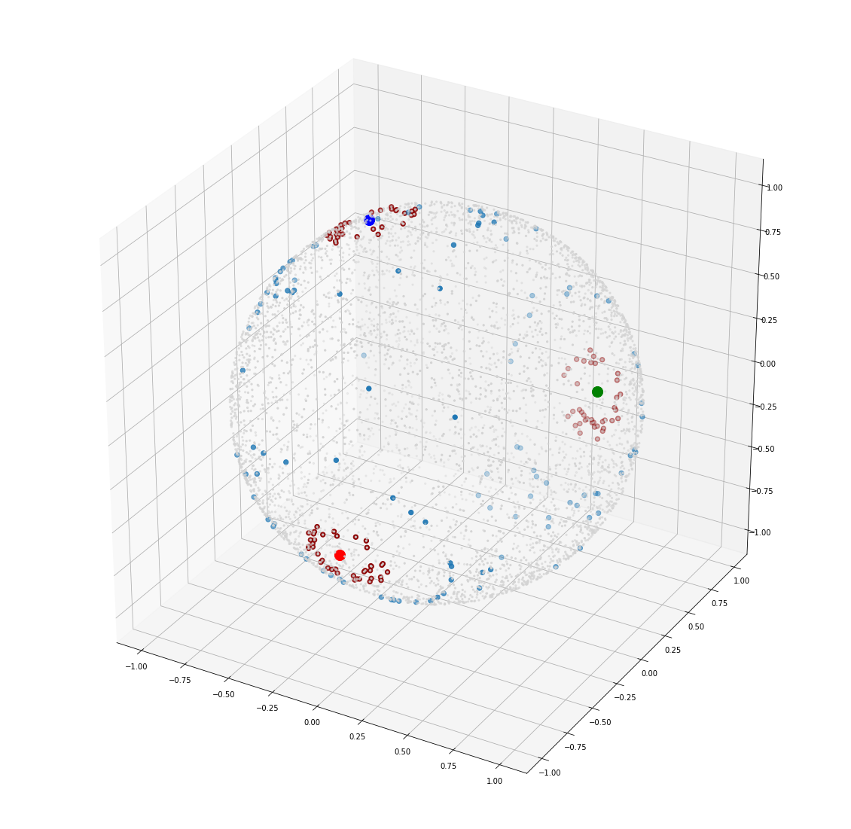
Another Example

Slide 27
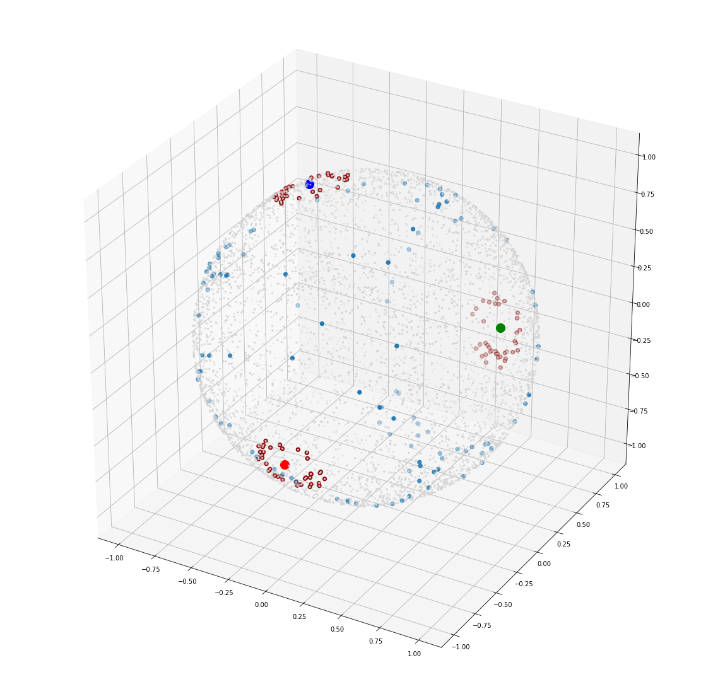

Slide 28
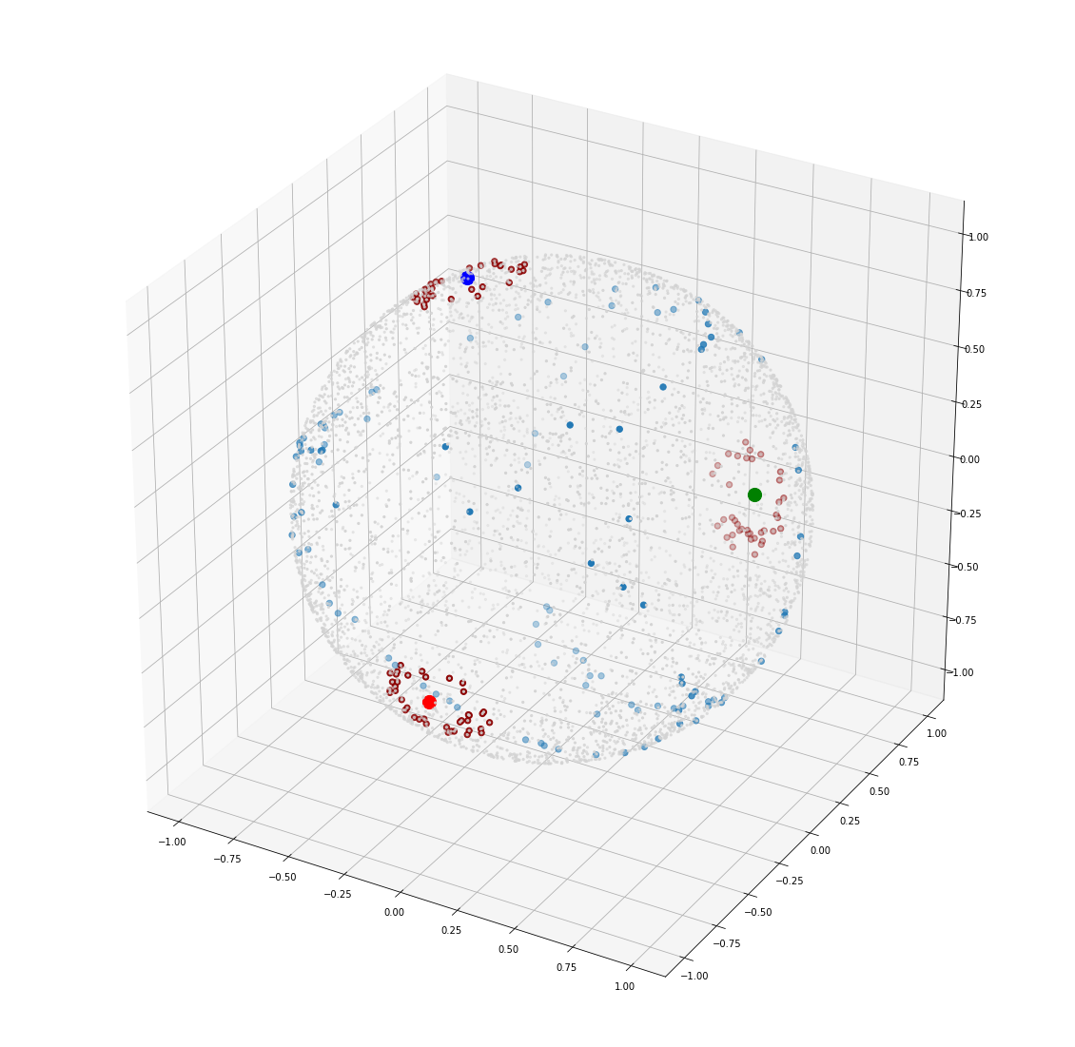

Slide 29
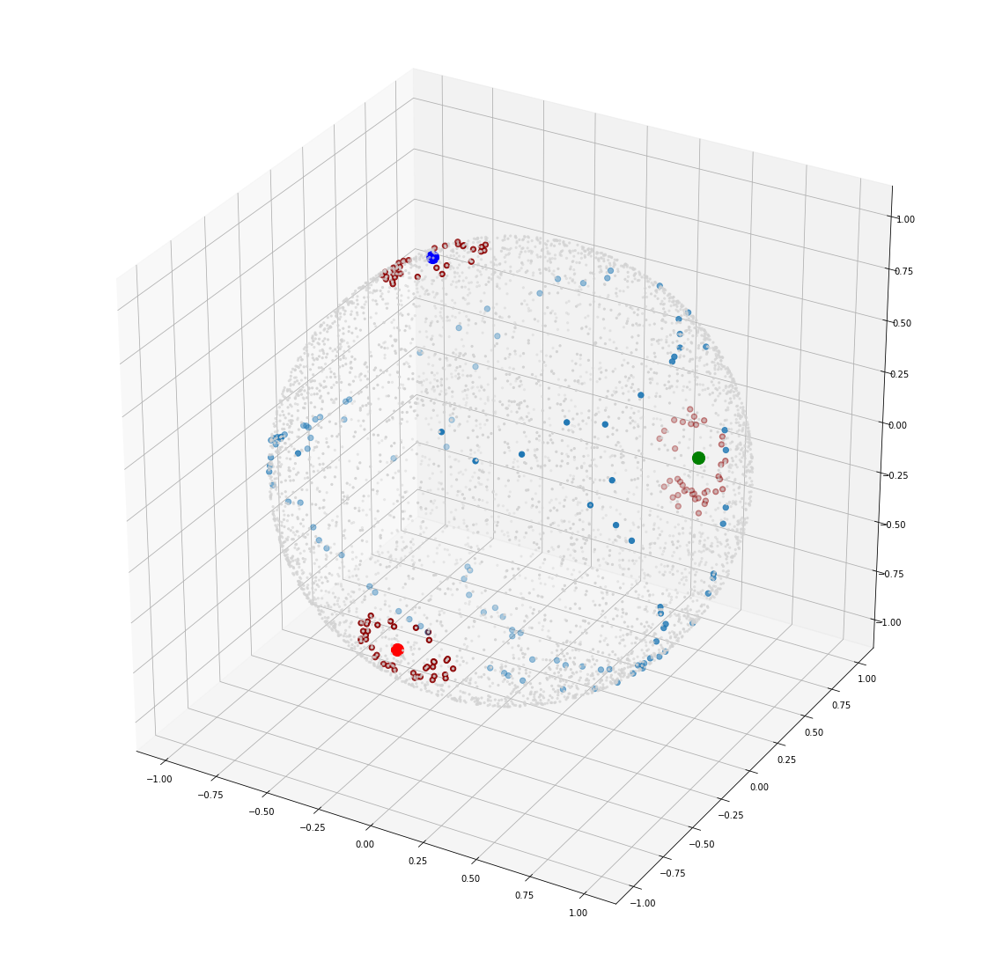

Slide 30
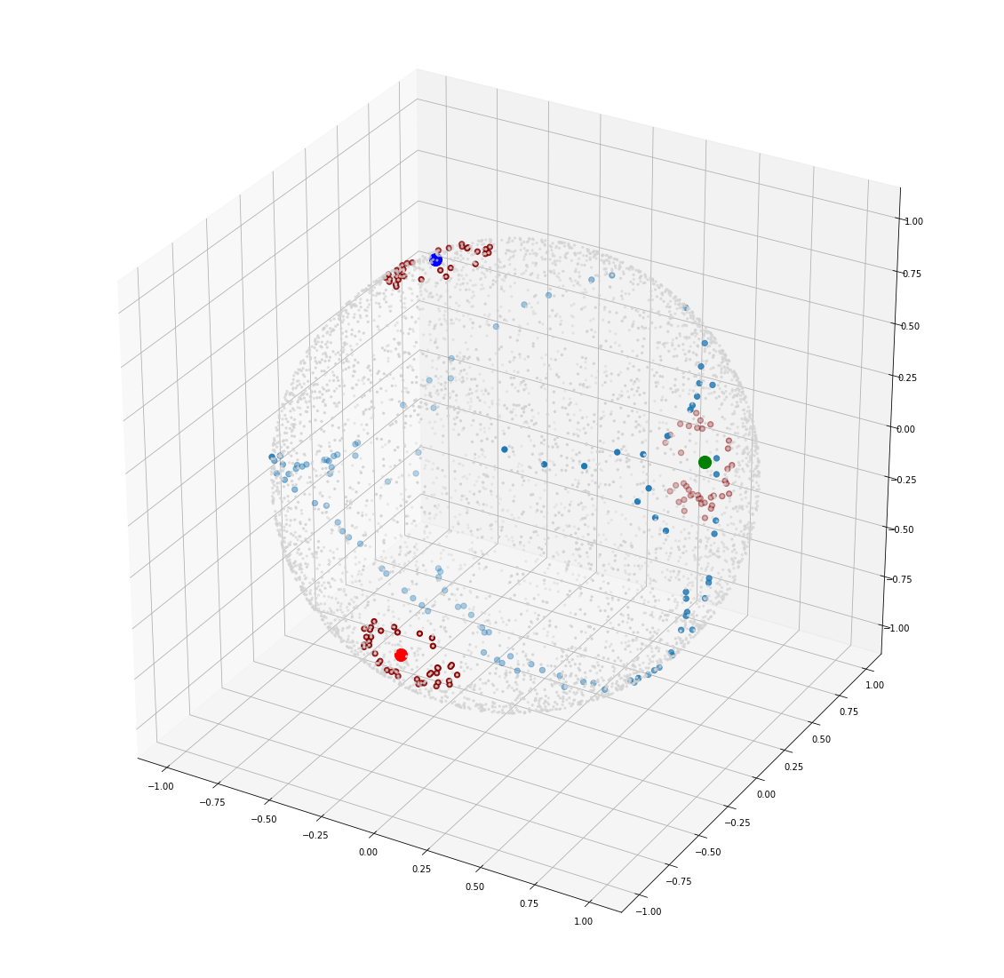

Slide 31
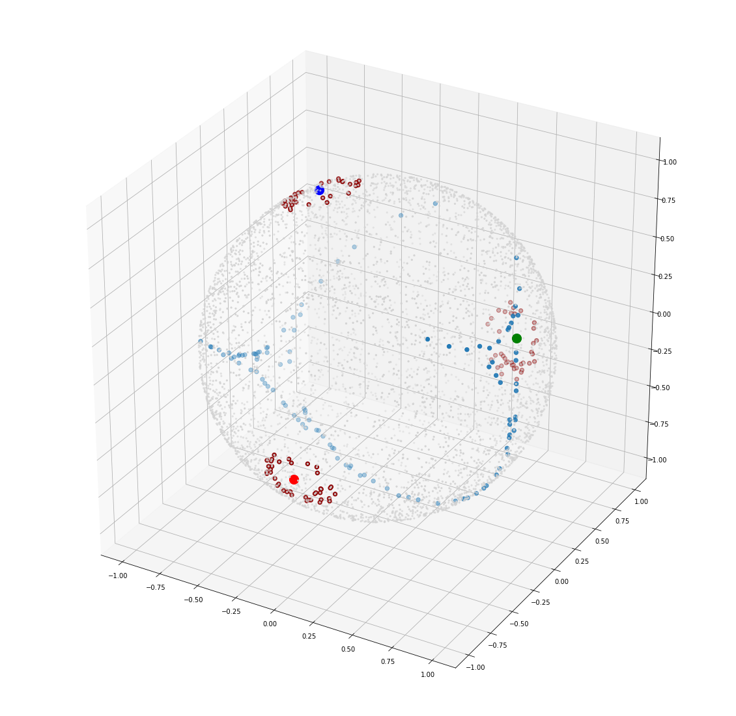

Slide 32
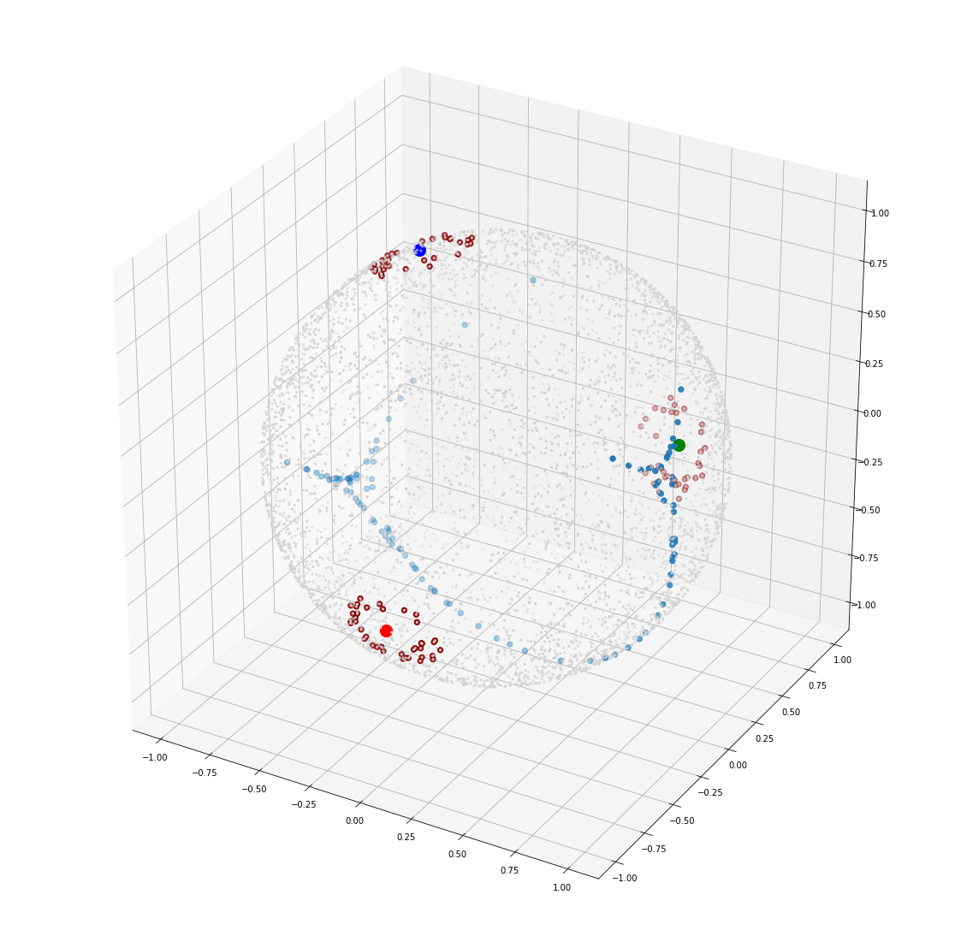

Slide 33
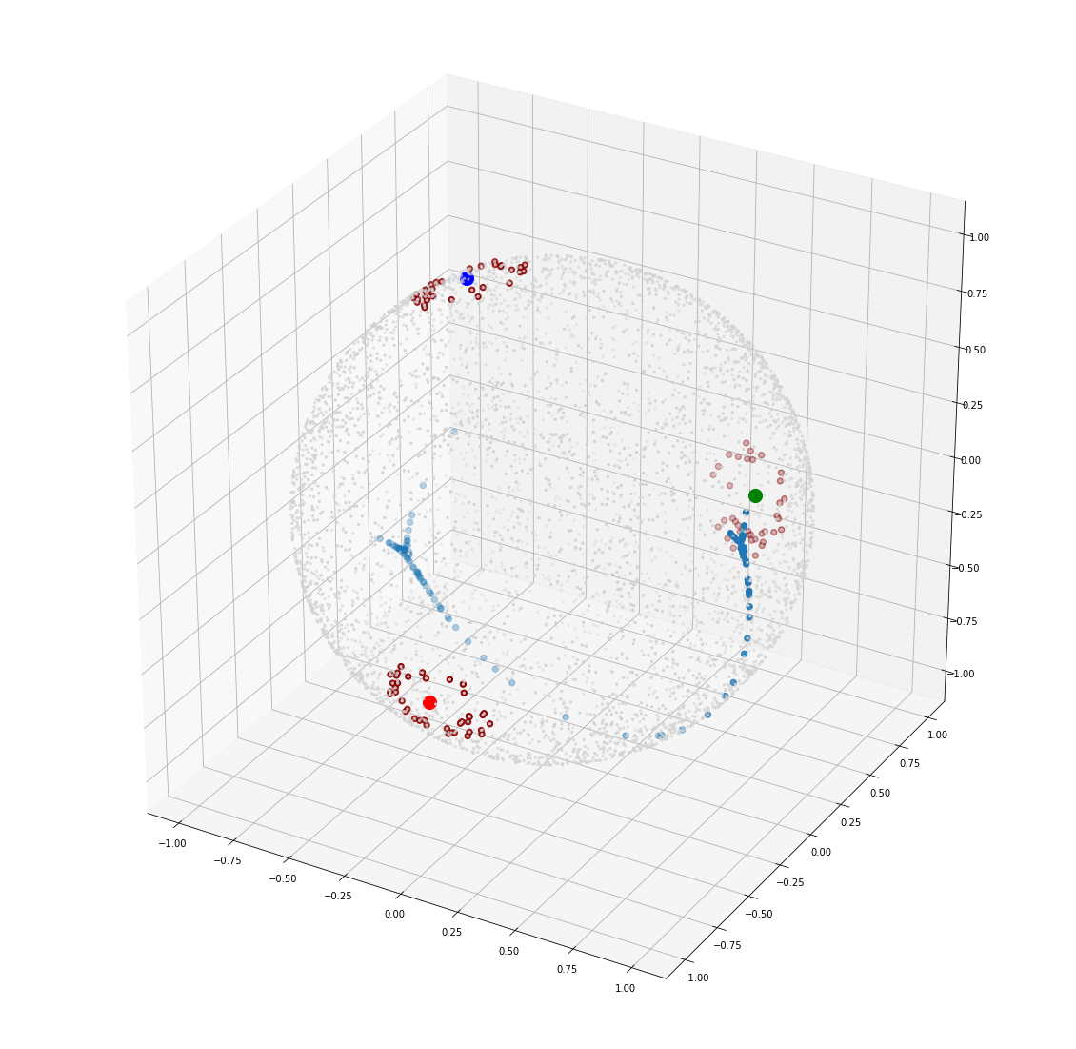

Slide 34
SupCon loss is similar to the simple distance-based loss It doesn’t ‘highly penalize’ a point for being near to cluster centroid

Slide 35


Slide 36
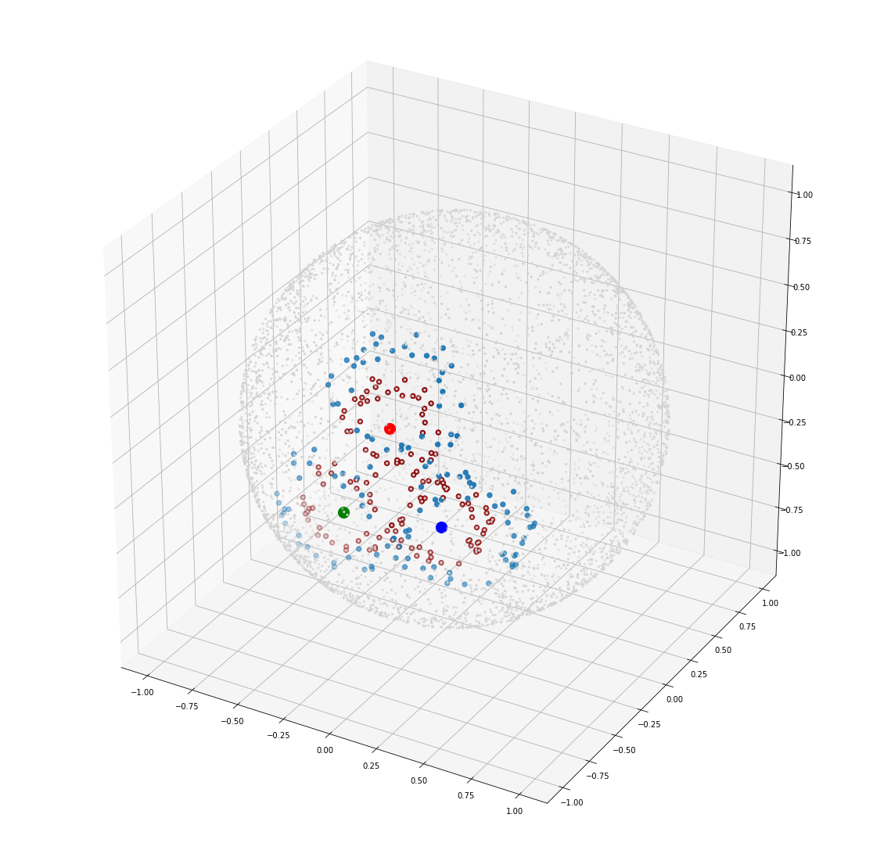

Slide 37


